Slide 1

Compare Apttus vs. SteelBrick
www.pwchk.com
Strictly Private and Confidential
Draft
11 February 2015

Slide 2


CROWD
–
Rating | 3.7 out of 5 stars |  | 4.4 out of 5 stars
Meets Requirements | 7.7 Based on 40 reviews |  | 8.6 Based on 82 reviews
Usability | 7.5 Based on 40 reviews |  | 8.7 Based on 82 reviews
Setup | 7.1 Based on 22 reviews |  | 7.8 Based on 66 reviews
Maintenance | 7.9 Based on 20 reviews |  | 8.0 Based on 68 reviews
Support | 8.0 Based on 33 reviews |  | 9.3 Based on 81 reviews
Ease of Business | 8.6 Based on 23 reviews |  | 9.3 Based on 66 reviews
Product Direction | 7.6 Based on 38 reviews |  | 9.0 Based on 84 reviews
Reviewers' Company Size | Small Business (50 or fewer emp.) | 6.5% | Small Business (50 or fewer emp.) |  | 22.1%
 | Mid-Market (51-1000 emp.) | 41.3% | Mid-Market (51-1000 emp.) |  | 69.8%
 | Enterprise ( >1000 emp.) | 52.2% | Enterprise ( >1000 emp.) |  | 8.1%
Reviewers' Industry | Computer Software | 38.00% | Computer Software |  | 43.8%
 | Information Technology and Services | 8.00% | Information Technology and Services |  | 12.5%
 | Telecommunications | 6.00% | Telecommunications |  | 4.2%
 | Internet | 6.00% | Internet |  | 4.2%
 | Hospital & Health Care | 6.00% | Hospital & Health Care |  | 3.1%
 | Other | 36.00% | Other |  | 32.0%
Pricing | Not enough data available |  | Basic | $30 user/month
 |  |  | Professional | $55 user/month
 |  |  | Enterprise | $85 user/month
Source | https://www.trustradius.com/compare-products/apttus-vs-steelbrick-cpq
Compare Apttus vs. SteelBrick •

Slide 3
trustradius
–
Rating | 7.9 Based on 25 reviews and ratings | 8.5 Based on 12 reviews and ratings
Likelihood to Recommend | 8.3 | 8.5
Likelihood to Renew | 7.1 | 9.1
Usability Rating | 8.0 | 8.8
Availability Rating | 10.0 | 9.1
Performance Rating | 10.0 | No rating yet
Overall Support Rating | 8.0 | 9.1
Online Training | 7.0 | No rating yet
Implementation Rating | 1.0 | No rating yet
Source | https://www.trustradius.com/compare-products/apttus-vs-steelbrick-cpq
Compare Apttus vs. SteelBrick •

Slide 4
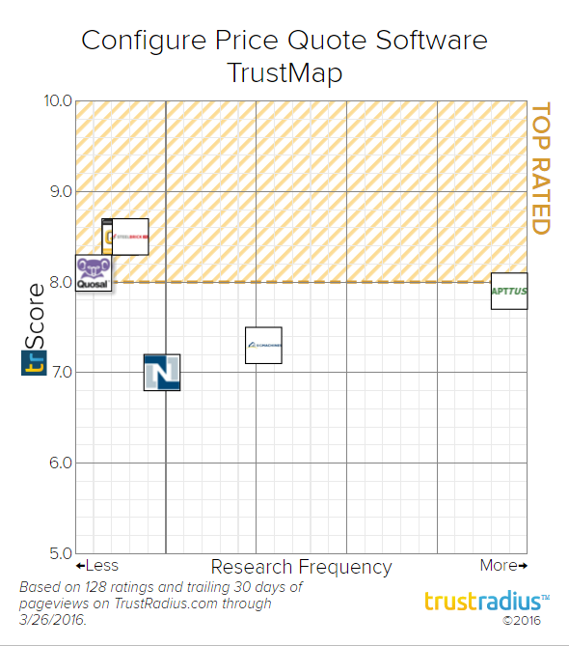
Configure Price Quote Software TrustMap
–
Compare Apttus vs. SteelBrick •

Slide 5
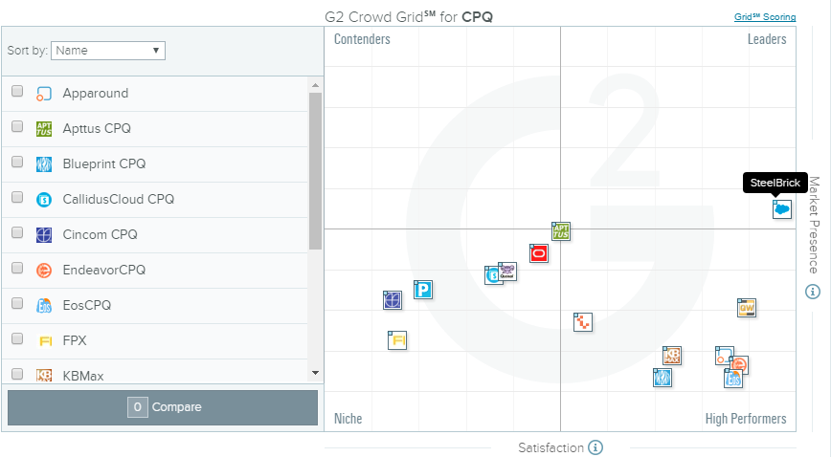
Best CPQ Software - Name
–
Compare Apttus vs. SteelBrick •

Slide 6
Thank you
This document is provided solely in connection with the Request for Proposal (“RFP”) dated 10 September 2015 for the provision of the relevant tools and its associated services for the Customer Relationship Management ("CRM") System initiative of Hong Kong Broadband Network Limited ("HKBN"). This is a proposal and does not constitute a contract of engagement with PricewaterhouseCoopers Consulting Hong Kong Limited (“PwC”). In the event that our proposal to you is successful, we will agree formal contractual terms with you before we begin any substantive work. In the meantime, this document is provided on the basis that PwC accepts no liability—whether in contract, tort (including negligence), or otherwise—to HKBN or to any other person in respect of this RFP. In addition, our acceptance of the engagement will be contingent upon the completion of all our internal engagement acceptance procedures.
This document must not be made available or copied in whole or in part to any other person without our express written permission.
© 2015 PricewaterhouseCoopers Consulting Hong Kong Limited. All rights reserved. In this document, "PwC" refers to PricewaterhouseCoopers Consulting Hong Kong Limited, which is a member firm of PricewaterhouseCoopers International Limited, each member firm of which is a separate legal entity.

